Slide 1

DROWSY DRIVER DETECTION SYSTEM
COMP4060 – CPD PROJECT
Why and How
Matters to the Society and My CPD
By -
Sahithi Kodali
Student ID: 45712050

Slide 2
Contents
Introduction
Importance and Motivation
Tools and Technologies
Types of Implementation
- Implementation 1
- Implementation 2
Drawbacks and Learnings
How it assisted in my CPD?

Slide 3
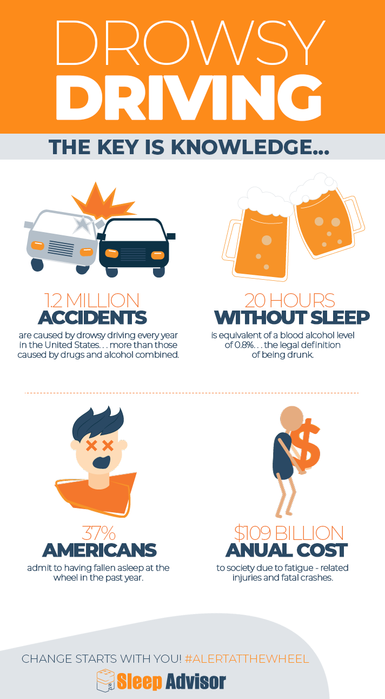
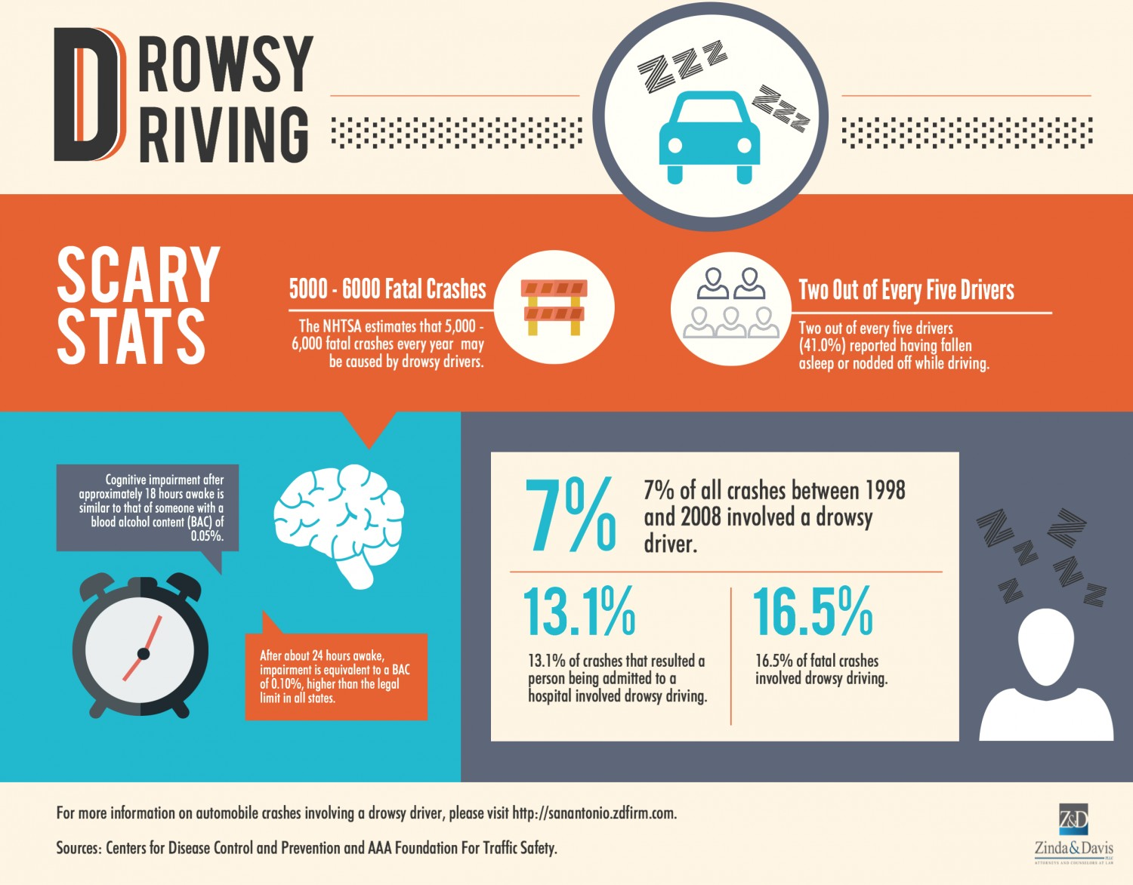
Introduction
In this busy world, it has become so essential to handle many tasks leading to insufficient amounts of sleep
Insufficient sleep => Drowsy driving => Fatal Accidents
Solution: ‘Drowsy Driver Detection System’

Slide 4
Importance and Motivation
Helps society by reducing number of accidents
Concepts related to Computer Vision and Deep Learning Neural Networks
Assist in my CPD
Reach End goal

Slide 5
Tools and Technologies
Anaconda Framework
Google Drive and Collab
Opencv, Keras, Tensorflow, Neural Networks
Python Language

Slide 6
Types of Implementations
1.) Using Web Cam
2.) Using Convolutional Neural Network

Slide 7
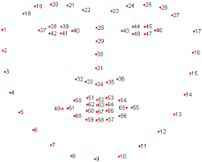
Implementation 1
Webcam based Implementation
Involves Feature extraction
Detect 68 landmarks points of the face
https://www.researchgate.net/figure/The-ibug-68-facial-landmark-points-mark-up_fig9_327500528

Slide 8
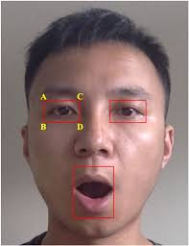
Implementation 1
Webcam based Implementation
Involves Feature extraction
Detect 68 landmarks points of the face
Region of Interest is Eyes and Mouth
https://ieeexplore.ieee.org/stamp/stamp.jsp?arnumber=8808931

Slide 9
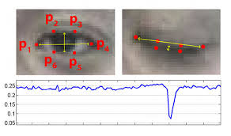
Implementation 1
Extract Region of Interest as Eyes and Mouth
Eyes and Yawn normalizing
https://www.pyimagesearch.com/2017/04/24/eye-blink-detection-opencv-python-dlib/

Slide 10

Implementation-1: Demo Video

Slide 11
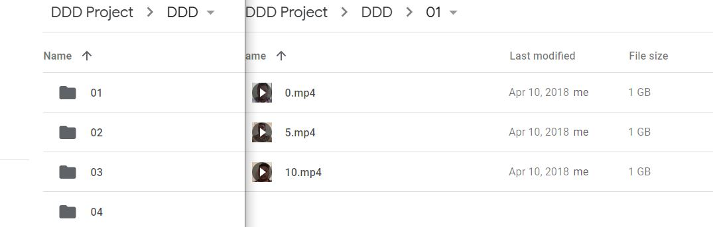
Implementation 2
Dataset of 30 videos
Each video with 3 sub videos classified as
1.) Alert ( 0.mp4)
2.) Slightly Drowsy (5.mp4)
3.) Drowsy (10.mp4)

Slide 12
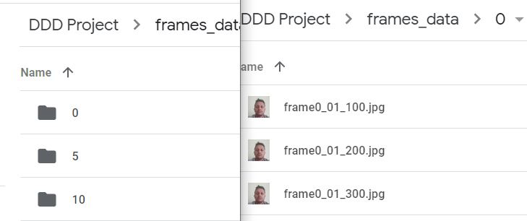
Implementation 2
Extract frames from each video (about 10000 frames)
Data Processing (Rotate, Resize to 240 * 135 dimensions)

Slide 13
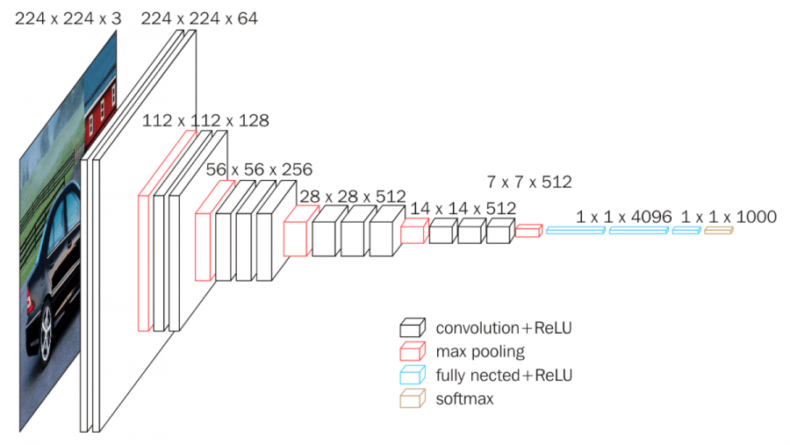
Implementation 2
Train model using CNN architecture
VGGnet , Best architecture for Multiclassification
https://neurohive.io/en/popular-networks/vgg16/

Slide 14
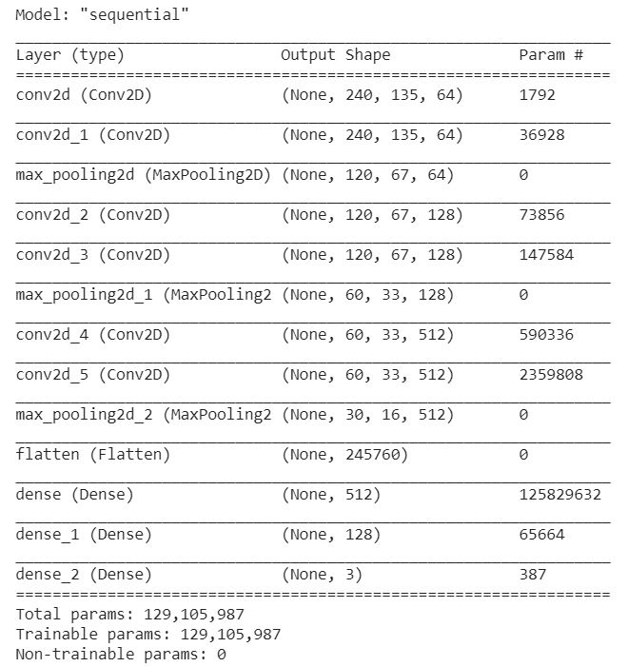
Implementation 2
Summary of the CNN Architecture used

Slide 15
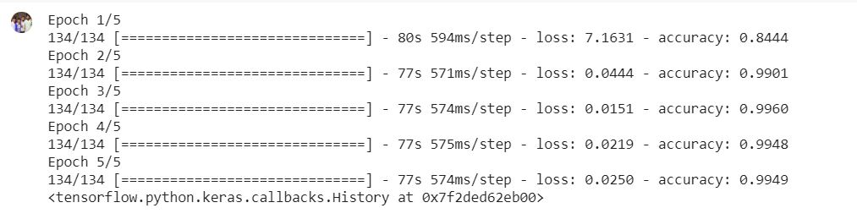
Implementation 2
Training 70% dataset
Testing 30% dataset
Division of epochs
Evaluate Accuracy

Slide 16
Drawbacks and Learnings
Drawbacks:
- Real time testing for CNN model is not executed
- Excessive Trail and Error Approach
Learnings:
- Importance of Standard Dataset
- Significance of Data processing
- Role of Architecture chosen

Slide 17
How it assisted in my CPD
Exposure towards Computer Vision
Exposure towards Deep Learning
Understand Feature Extraction
Enhance knowledge on CNN Architectures
Evaluation techniques
Reach the goal of Data Science engineer

Slide 18
- Thank You -

